Slide 1


Real-time data integration for hybrid and multicloud environment
STREAMSETS ARCHITECTURE
Notes:
In a world where data never stops, streaming data enables businesses to make decisions at the speed they demand.
StreamSets empowers data engineering teams to onboard new data sets in minutes and operationalise data delivery at a fraction of the cost.
60% Reduction in Engineering efforts
98% Faster to Deliver New Data
50% More Productivity in the DataOps Lifecycle

Slide 2



The value of streaming data pipelines
Companies need to build, run, manage and monitor streaming data pipelines at scale, across environments; and transform the data in flight as it is collected.
According to a Forrester study, 87% of organizations require data to be ingested and analyzed within one day or faster. Since this 2018 study, data variety, volume, and velocity continues to rise.
IBM StreamSets adds data ingestion capabilities to watsonx and further extend the breadth and depth of IBM’s Data Fabric and Data Integration capabilities through enabling the design of real-time data pipelines.
Notes:
So, while the promise of a modern data integration workload is clear, only the organizations that can accelerate deployment, improve the productivity of their engineers, and accelerate their business use cases will be those to gain a competitive advantage.
Companies are no longer searching for individual and best-of-breed tooling. Instead, they’re looking for integrated, end-to-end data platforms that can:
Support data integration across a hybrid and multicloud data landscapes. Gartner estimates that nearly half of data management implementations use both on-premises and cloud environments, which means hybrid data management and integration support has therefore become critical in the marketplace.
Enable faster self-service access to data for non-IT roles. Self-service data access and data preparation may be conducted by citizen integrators, non-IT roles, or by skilled data engineers. These varied personas spur additional requirements for data integration tools.
Automate, orchestrates, and ingest data from various sources. Observability tools have the potential to improve the quality of software, because previously invisible (or unknown) defects and anomalies can be identified and corrected. By enabling product owners to better understand how their products are used, data observability tools can not only reduce the number of service outages—but also their severity.
The good news is that IBM’s data fabric solution is an integrated, end-to-end platform that supports more than one use case; it’s an enterprise data strategy that can support tens of use cases, including customer personalization, the internet of things (IoT), and real-time analytics.

Slide 3
While data integration remains a priority for organizations, challenges remain
Key challenges
Data access
50% of data analyst time is spent working reactively or trying to find or get access to data²
Data drift
80% of data engineering time is spent on maintaining & fixing existing pipelines due to data drift, creating a costly maintenance burden³
Key priorities
67% of data leaders believe prioritizing integrating data from various sources is a key priority¹
75% of data leaders prioritize ingesting bulk data from disparate sources into the cloud¹
Data proliferation
With growing data volume and datasets organizations require scalability and faster response times
Data Latency
Need for processing data as it arrives to reduce delays in business decision and operations
Notes:
As this slide illustrates, data integration is a priority for organizations, challenges still remain when it comes to building a sound data strategy. The reality is, with growing data volume and datasets (also knows as data proliferation), organizations require scalability and faster response times. That means they need to process data as it arrives to reduce delays in business decision and operations in order to reduce data latency and time to value.
The problem is that 50%² of data analysts’ time is spent trying to find or get access to data, and 80% of data engineering time is spent on maintaining and fixing existing pipelines due to data drift, creating a costly maintenance burden.
Sources:
https://www.informatica.com/blogs/top-3-cloud-data-management-challenges-and-priorities-in-2022.html
https://towardsdatascience.com/how-should-analysts-spend-their-time-e390872ceb70
https://ibm.ent.box.com/s/84r4ypo9l8dl6s6yp3jgdaxz1u6qn19f

Slide 4

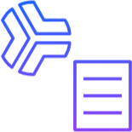
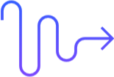
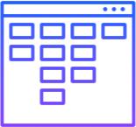
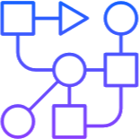

Benefits
IBM StreamSets extends IBM’s data integration plus ingestion capabilities to manage real-time streaming data
Enable real-time data ingestion, at scale
Reduce data drift with intelligent data pipelines​
Stream any data from any source (in any format)
Decrease data staleness and enable real-time data at scale—handling millions of records of data, across thousands of pipelines within seconds.
Insulate data pipelines from change and unexpected shifts with drag-and-drop, prebuilt processors designed to automatically identify and adapt to data drift.
Create streaming pipelines to ingest structured, semistructured or unstructured data and deliver it to a wide range of destinations.
Drag-and-drop user interface ​
Enable deployment flexibility
Harness the Python SDK for enterprise-scale productivity
Leverage a single low-code user interface that designs and deploys smart data pipelines for streaming data without hand coding.​
Deploy our SaaS solution on AWS, Azure, GCP and run workloads where your data resides—in your cloud provider, VPC or local infrastructure.
Streamline the process of creating and deploying many pipelines with Python SDK​. Leverage templates and a blend of graphical user interface (GUI) tools to make data accessibility more inclusive.
Notes:
As shown on the IBM StreamSets (StreamSets) website, StreamSets provides the following client benefits:
Enable real-time data ingestion at scale. Build reliable streaming data pipelines across hybrid-cloud environments to decrease data staleness and enable real-time insights and accelerate decision-making processes.
Reduce data drift with intelligent data pipelines. Insulate data pipelines from changes and unexpected shifts with pre-built drag-and-drop stages designed to automatically identify and adapt to data drift.
Stream any data, from any source. Create seamlessly adapting streaming pipelines for structured, semi-structured, or unstructured data and automatically detect and alert users to changes in schemas.
Leverage drag-and-drop user interface. Use StreamSets user interface that designs and deploys smart data pipelines for streaming data without hand coding.
Scripting extensibility. Deploy the software-as-a-service (SaaS) solution on Amazon Web Services, Microsoft Azure, or Google Cloud Platform and run workloads where the data resides—in “the cloud”, virtual private cloud and/or on-premises local infrastructure.
Harness the Python SDK for enterprise-scale productivity. Streamline the process of creating and deploying many pipelines with Python SDK​. Leverage templates and a blend of graphical user interface (GUI) tools to make data accessibility more inclusive.
Sources:
“IBM StreamSets is now available for real-time decision making”, IBM: https://www.ibm.com/blog/announcement/ibm-streamsets-ga/
IBM StreamSets website: https://www.ibm.com/products/streamsets
IBM StreamSets documentation: https://docs.streamsets.com
Notes to sellers:
According to Gartner, by 2028, large enterprises will triple their unstructured data capacity across their on-premises, edge, and public cloud locations compared to mid-2023. Just as data formats are changing, data continuously changes over time as a result of many factors, such as changes in schema, volume, or data collection methods.
The concept, data drift, refers to the change specifically in schema structure that can break definitions in data pipeline leading to costly re-writing or re-factoring of pipelines.
With IBM StreamSets, clients can address varying data formats and data drift with a solution that operationalizes real-time data integration by creating and managing smart streaming data pipelines to support the high-quality data that is needed to drive digital transformation.

Slide 5
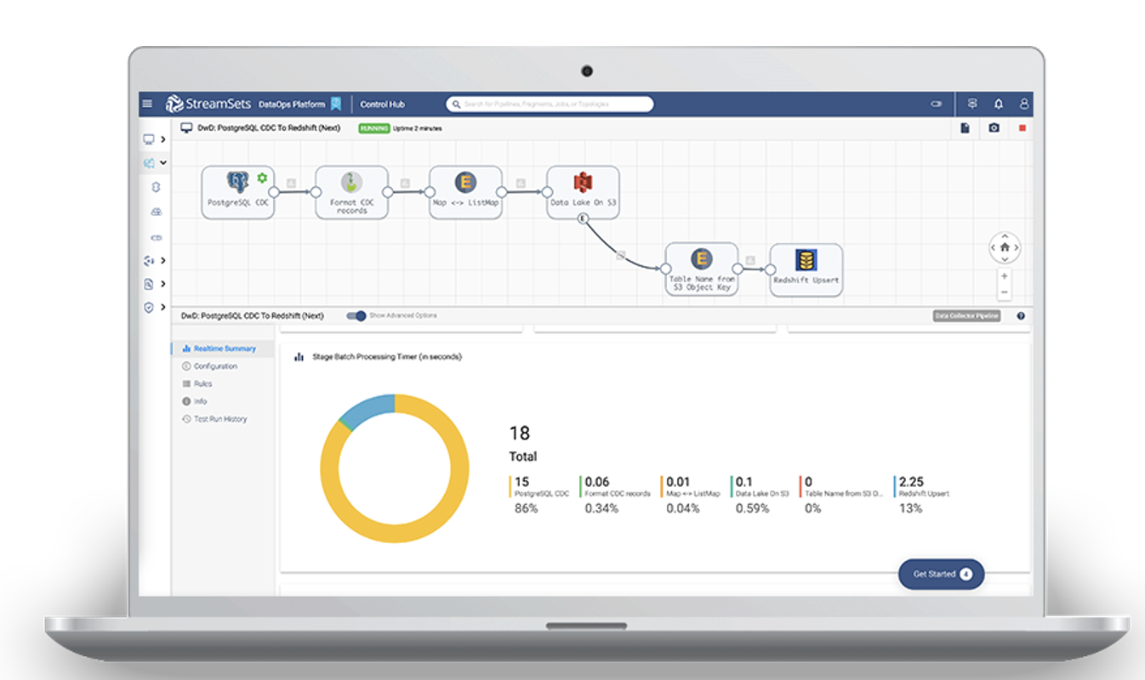
Why IBM StreamSets?
10x Your Data Team’s Productivity¹
Pre-built connectors, transformations and an intuitive visual interface enables data engineers to support more quickly support data requests.
Reduce Maintenance Time by 80%¹
Spend more time doing and less time fixing broken pipelines due to data drift or schema changes with automatic updates and no rewrites
Data Locality
Reduce data egress ensuring data is processed in-place. IBM StreamSets runs within your on-premises or cloud infrastructure
Real-Time delivery
Data streaming and flexibility in ingestion streaming
Notes:
So, what makes IBM StreamSets different from other solutions in the market?
The first is its visual oriented design with pre-built connectors, transformations, and an intuitive visual interface enables data engineers to quickly support data requests, boosting team productivity by 10x! Next, IBM StreamSets offers a schema-on-read approach that can reduce maintenance time by 80% because teams spend less time fixing broken pipelines due to data drift or schema changes. And finally, one of the other great things about IBM StreamSets is its ability to run wherever the data is, whether that’s within an on-premises or cloud infrastructure. As many organizations have learned the hard way, data egress (the movement of data from their cloud data store (for transformations, reporting, etc.) can be difficult to predict and understand, and they can have a significant impact on large organizations that move large amounts of data regularly. Here are some examples of data egress costs for different cloud providers²:
Amazon Web Services charges $0.09 per GB for the first 10 TB of data egress per month, $0.085 per GB for the next 40 TB, $0.07 per GB for the next 100 TB, and $0.05 per GB for anything over 150 TB. The first 100 GB of data egress from Amazon EC2 instances to the public internet is free.
Google Cloud Platform charges $0.12 per GB for the first TB, $0.11 per GB for up to 10 TB, and $0.08 per GB after 10 TB.
Microsoft Azure charges $0.087 per GB for up to 10 TB, and $0.083 per GB for up to 40 TB.
StreamSets enables organizations to be able to reduce data egress by ensuring data is processed in-place, where it resides or is created. This not only reduces costs, but also provides higher performance because there is no need to transfer the data over the network for processing.
---------------------
Sources:
https://ibm.box.com/s/azbb9946o1henqgdo4h2h51y40xjb9hl
https://www.google.com/search?q=Cost+of+data+egress&rlz=1C5GCCM_en&oq=Cost+of+data+egress&gs_lcrp=EgZjaHJvbWUyBggAEEUYOTIHCAEQIRigATIHCAIQIRigAdIBCjYwNjYzM2owajeoAgCwAgA&sourceid=chrome&ie=UTF-8

Slide 6
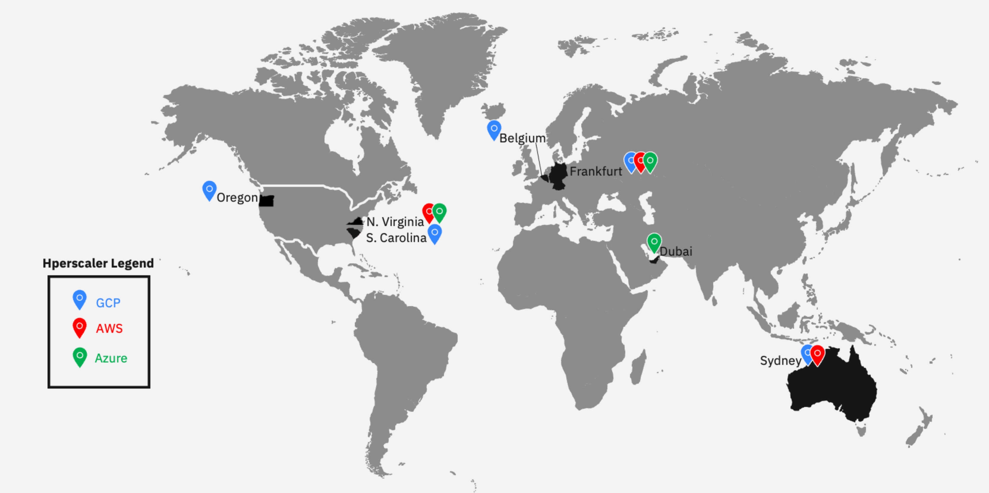
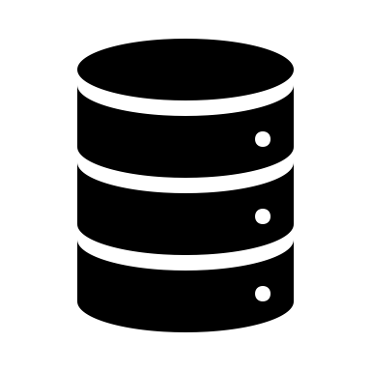
IBM StreamSets as-a-Service
Control Plane
Control Hub: Build, Manage, and Monitor pipelines in these regions
The IBM StreamSets solution features a Control Plane and a Data Plane.
The Control Hub (control plane) is a web-based UI that can be hosted in 11 regions, while the Data Collector engines (data plane) can be deployed anywhere.
IBM StreamSets separates the control plane from the data plane, ensuring data processing stays within the client's environment, reducing exposure risks and supporting regulatory compliance.
Data Plane
Engines – Deployed Anywhere the data is
Notes:
Let’s break down the IBM StreamSets solution in a little more detail. It’s comprised of two planes, a Control Plane and a Data Plane. The StreamSets Control Plane consists of the StreamSets Control Hub and the StreamSets Data Plane. The Data Plane runs on a public cloud service (Amazon Web Services [AWS], Google Cloud Platform [GCP], and Microsoft Azure) hosted by StreamSets that users can access through a web browser to build, manage, and monitor data pipelines.
The Data Plane offers engines capable of executing data ingestion pipelines that can read from and write to a wide array of heterogeneous sources, such as Amazon S3, Google Big Query as well as destinations like Kafka, MongoDB, PostgreSQL, Db2, Snowflake, and Splunk. These engines can be deployed anywhere. StreamSets operates within clients' on-premises or cloud infrastructure, as the data collector engines are deployed in the same environment. Consequently, the data stays within a clients' environment, minimizing exposure risks and supporting regulatory compliance.
As of 4Q2024, StreamSets is available (the SaaS service model) on Amazon Web Services (AWS), Microsoft Azure (Azure), and Google Cloud Platform (GCP). Cloud provider data centers are:
AWS: Northern Virginia, Frankfurt, and Singapore.
Azure: Northern Virginia, Frankfurt, and Dubai
GCP: Oregon, South Carolina, Frankfurt, Belgium, and Sydney
Terminology:
SaaS: Software-as-a-Service

Slide 7

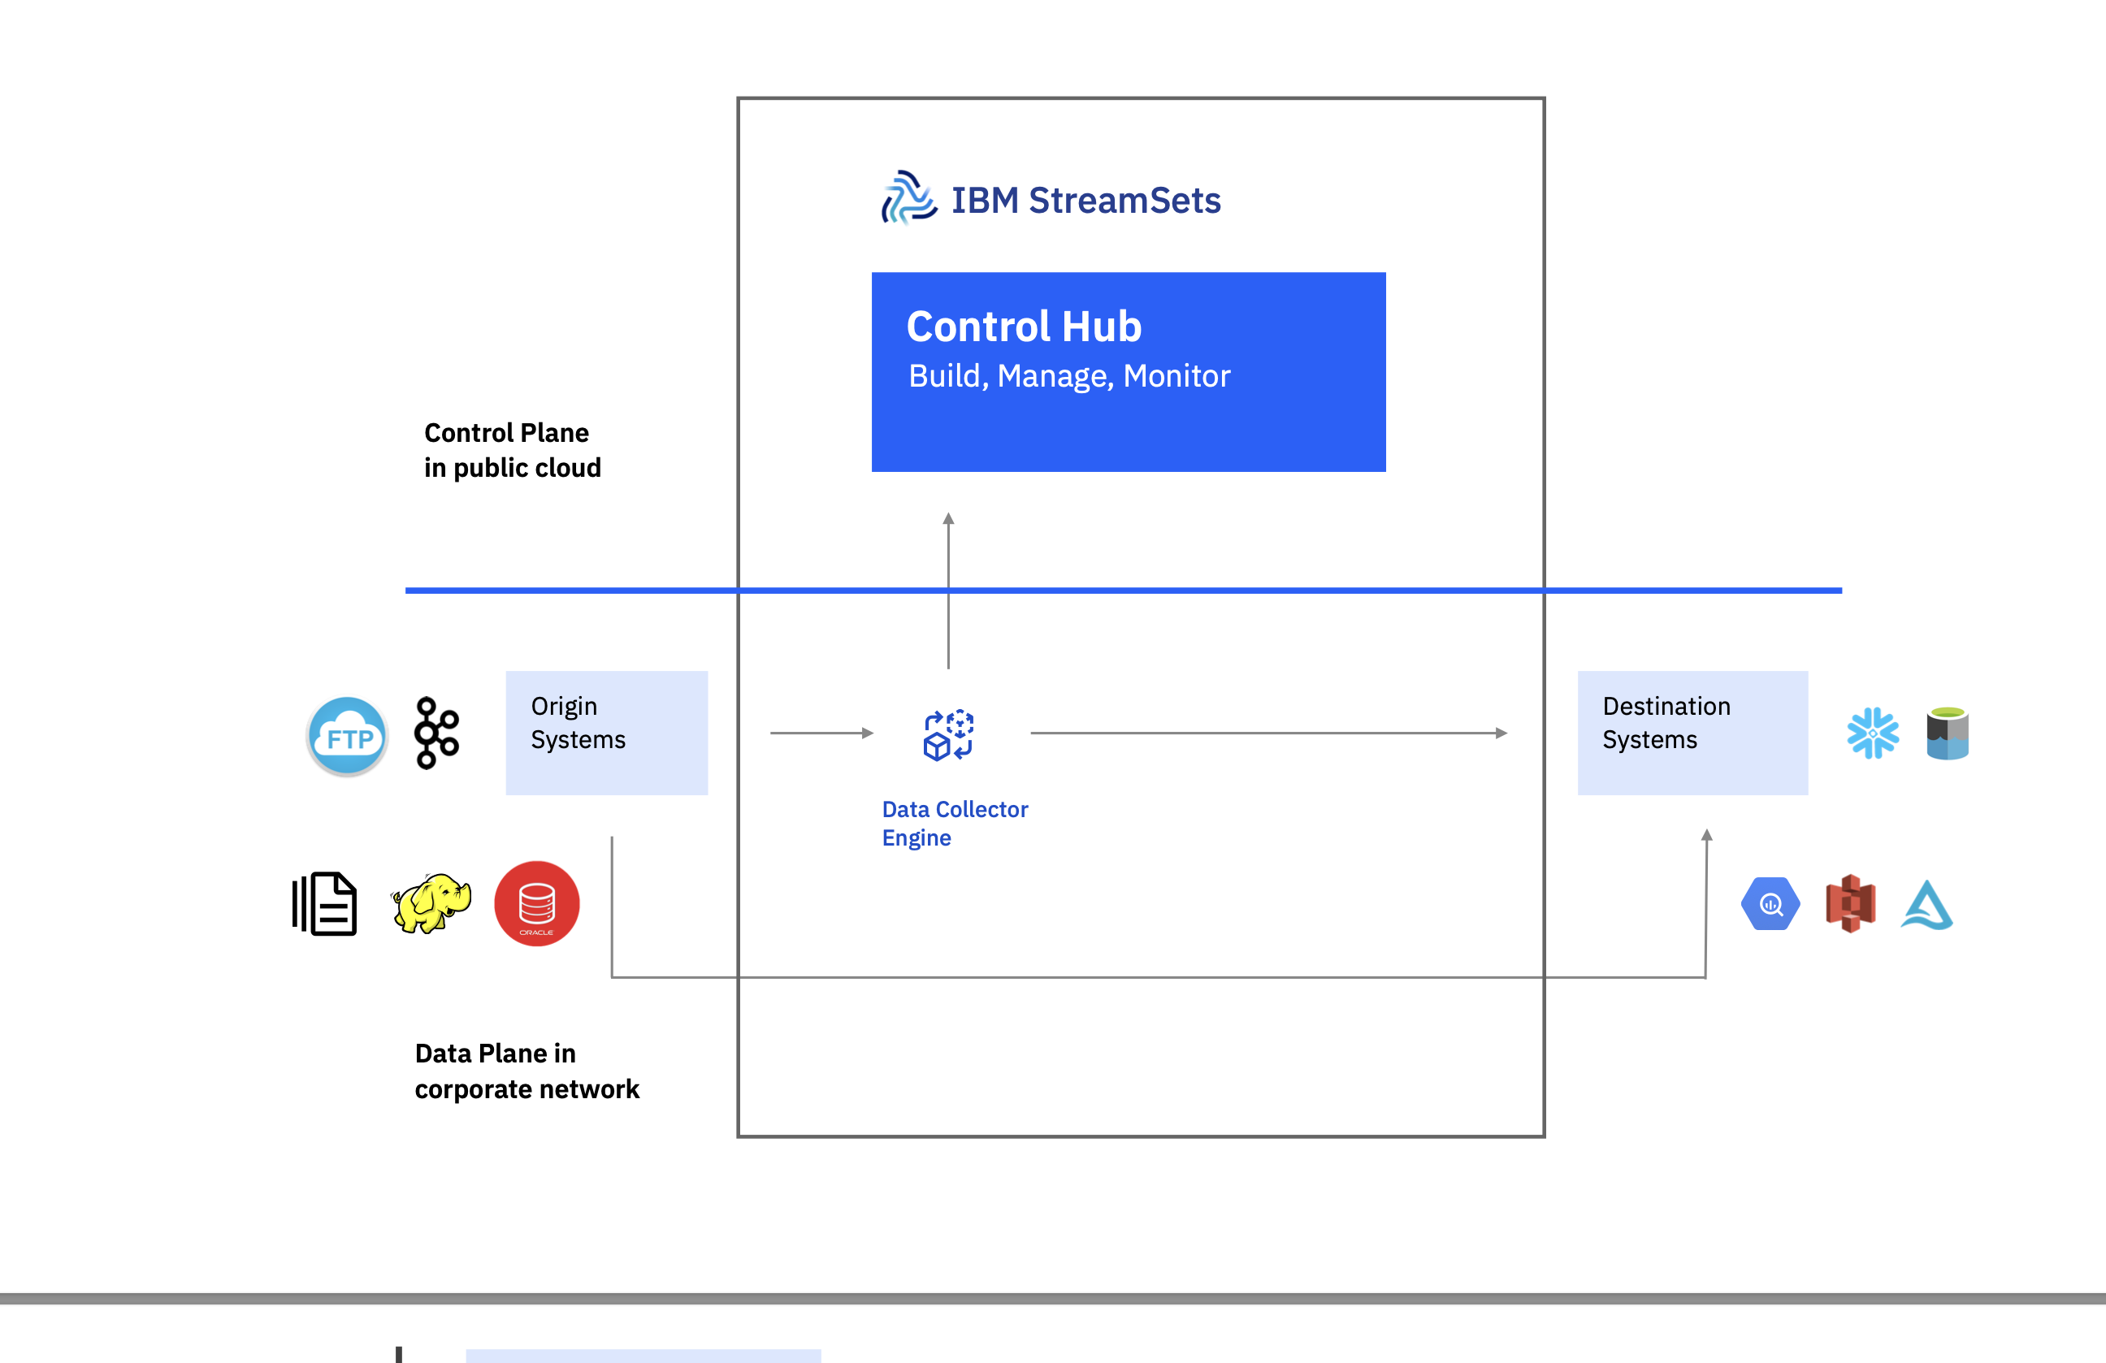

IBM StreamSets Client managed option
The IBM StreamSets solution offers a fully client managed offering featuring both the Control Plane and a Data Plane on-premises.
The Control Hub (control plane) can be hosted in IBM's Software Hub, while the Data Collector engines (data plane) can be deployed anywhere.
IBM StreamSets ensures data processing stays within the client's environment, reducing exposure risks and supporting regulatory compliance.
Control Hub
Build, Manage, Monitor
Control Plane
in public cloud
Origin
Systems
Destination
Systems
Data Collector
Engine
Notes:
With the IBM StreamSets (StreamSets) client managed option the client manages the resources in both Control Plane and Data Plane. The Data Plane is as before, 100% unchanged, clients will still have data plane engines in the environment of their choice. Control Hub is deployed as a client managed software where clients deploy Red Hat OpenShift and Cloud Pak for Data to manage their StreamSets cartridge.
The Data Plane, same as we saw before, offers engines capable of executing data ingestion pipelines that can read from and write to a wide array of heterogeneous sources, such as Amazon S3, Google Big Query as well as destinations like Kafka, MongoDB, PostgreSQL, Db2, Snowflake, and Splunk. These engines can be deployed anywhere. As before, StreamSets operates within clients' on-premises or cloud infrastructure, as the data collector engines are deployed in the same environment. Consequently, data stays within a clients' environment, minimizing exposure risks and supporting regulatory compliance.

Slide 8
Why clients desire client managed software?
Data Sovereignty
Regulatory and Compliance
Flexibility & Control
Compliance with laws requiring data to remain within the nation in which it originates
Organizations maintain complete control over their data
Avoids onerous processes around SaaS vendor approval
Overcomes industry-specific regulations governing SaaS providers
Ability to custom-tailor deployments to unique requirements
Flexible management of upgrade cycles and internal validation
Notes:
Why do some clients desire client managed software?
Business requirements of data sovereignty and regulations require a client managed software solution for IBM StreamSets (StreamSets). There are more and more laws that are beginning to govern industries that specify that data that is created in a particular nation must remain in the nation of origin. This applies to the data in the data plane, metadata about their pipelines, and the data used in the control plate.
Additionally, well established corporate procedures and processes for regulatory compliance make it difficult for companies to implement a software-as-a-service (SaaS) solution – a client managed software solution is the only viable option.
Finally, some clients desire the ability to custom-tailor deployments to their unique requirements, again making a client managed software solution their only viable option.
References:
IBM StreamSets website: https://www.ibm.com/products/streamsets
“What is data sovereignty?”, IBM: https://www.ibm.com/think/topics/data-sovereignty
Note:
The StreamSets Control Hub, which serves as the Control Plane, is deployed on-premises. Meanwhile, the Data Plane is deployed in a client's preferred environment, as is customary.

Slide 9

IBM StreamSets Cartridge
AI and Data Cartridges
Data Fabric
Data Management
Data Replication
DataStage
IBM StreamSets
Financial Crimes Insights
Financial Services Workbench
IBM Knowledge Catalog (Standard and Premium)
Knowledge Accelerators
Master Data Management
OpenPages
Product Master
Db2
Db2 Warehouse
Informix
Control Hub
Control Hub / Control Plane (cartridge)
Cloud Pak for Data
Red Hat OpenShift (restricted)
Business Analytics
AI Assistants
Charge metric: Virtual Processor Core
Part types: Perpetual, Subscription
Cognos Analytics
Cognos Dashboards
Planning Analytics
watsonx Assistant
watsonx Orchestrate
watsonx Discovery
Watson Speech Services
Note: The StreamSets Cartridges include restricted Red Hat OpenShift entitlements.
Notes:
As with other IBM Data and AI offerings, IBM StreamSets Client Managed is a Cartridge within Cloud Pak for Data. IBM StreamSets client managed includes an entitlement for Red Hat OpenShift and will leverage Cloud Pak for Data as a foundation layer, where the cartridge resides.
The charge metric for IBM StreamSets to be used as a client manage service will remain the same, that is, Virtual Processor Cores (VPC) – includes both perpetual and subscription pricing models.
What is a Cloud Pak for Data Platform Cartridge?
Simply put, a Cloud Pak for Data Platform Cartridge offers extended capabilities on top of an already extensive number of base services within Cloud Pak for Data Platform. The “cartridges” are an all-in-one entitlement to restricted Red Hat OpenShift and Cloud Pak for Data Platform software. This means when a client purchases a cartridge they can:
Leverage Red Hat OpenShift to deploy on their infrastructure of choice
Modernize workloads using containerized software
Have access to all base services
On the right of this slide are the Cloud Pak for Data Platform cartridges.
Terminology:
VPC: IBM Virtual Processor Core
Sources:
Cloud Pak Cartridges: https://www.ibm.com/products/cloud-pak-for-data/cartridges
“Virtual Processing Core”, IBM documentation: https://www.ibm.com/docs/en/license-metric-tool?topic=metrics-virtual-processor-core-vpc

Slide 10








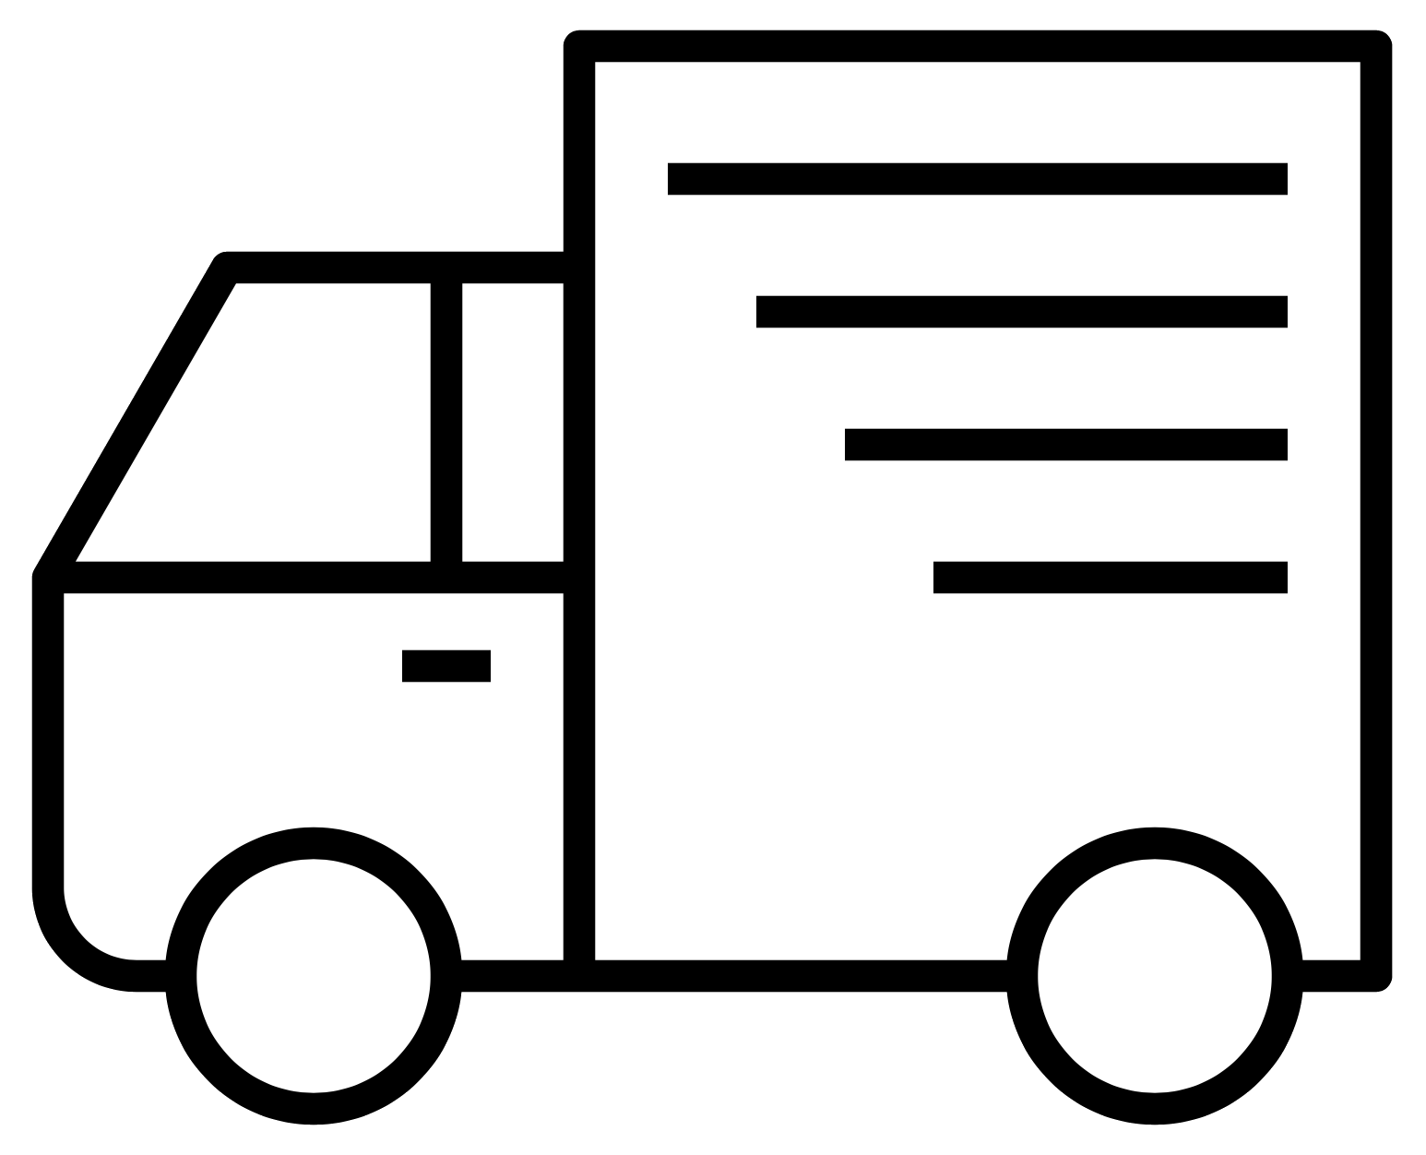
IBM StreamSets is a cross-industry product Here are some examples of how clients use IBM StreamSets for streaming data pipelines
Financial Services
Credit Monitoring
Regulatory Compliance
Real-Time Decision Making
Fraud Detection
Customer 360
Customer Churn
Healthcare
Predict Readmission
Clinical Data lake and Member 360
Pharma Supply Chain Optimization
Industrial
Predictive Maintenance
Vehicle & Fleet Management
Research and Development
Cybersecurity Defenses
More:
State/ local government
Telecommunications
…
10
Notes:
This slide shows the use cases within each industry that StreamSets has helped clients improve results, decrease latency, and decrease time to value.
As shared earlier, IBM StreamSets has helped clients in the areas of fraud detection and cybersecurity, but IBM StreamSets has also assisted clients in multiple industries across multiple different use cases with their real time data integration challenges.

Slide 11
STREAMSET
EXAMPLE USECASE

Slide 12




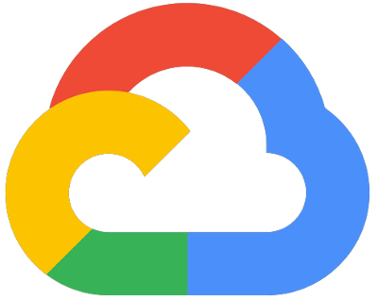
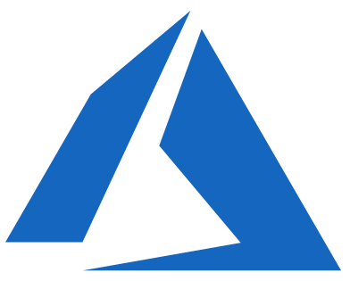
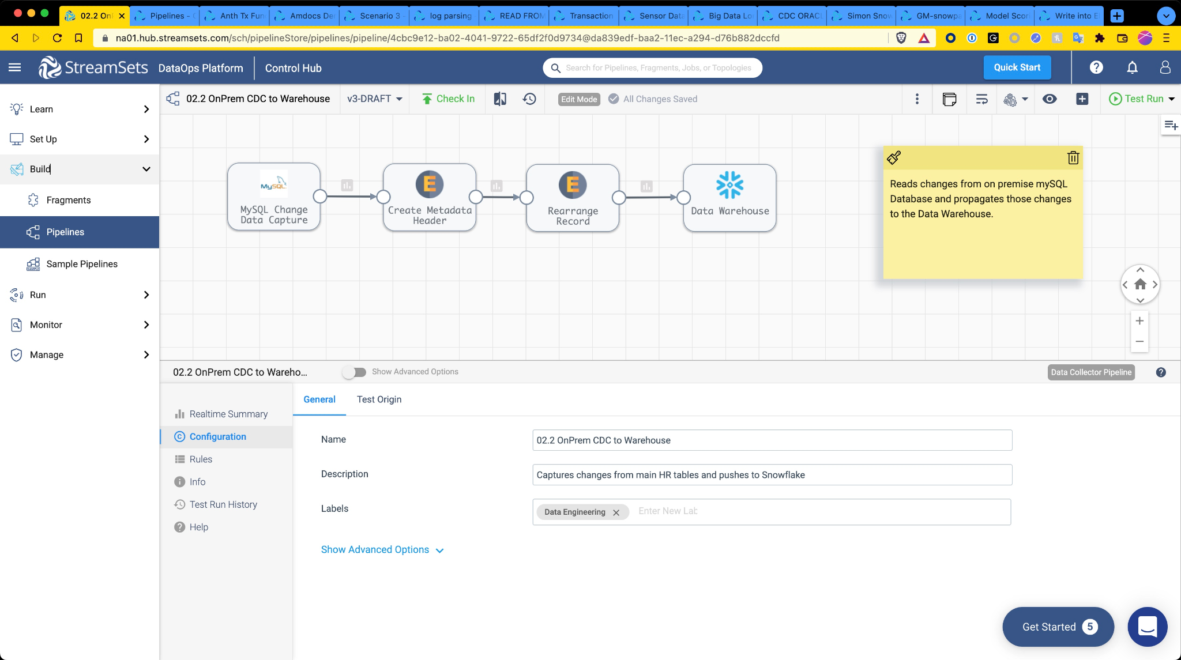

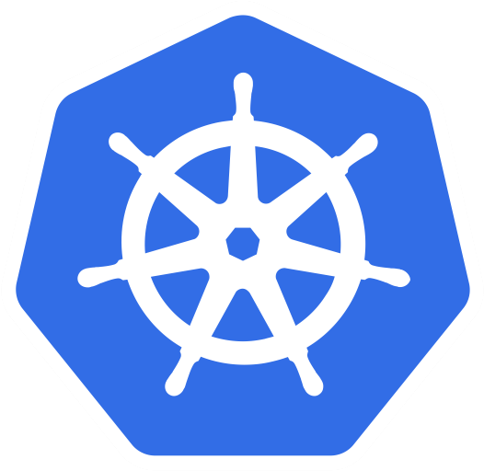
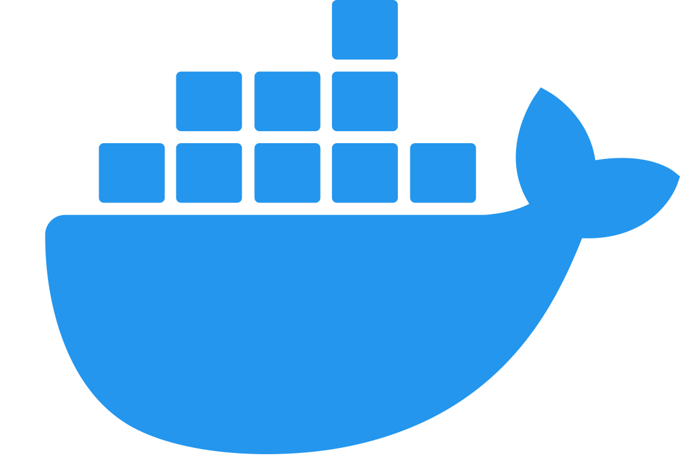
CDC to the Cloud
Pattern: CDC
Mode: Streaming
Origin
Dest
Engine Location:
Engine Env:

Slide 13
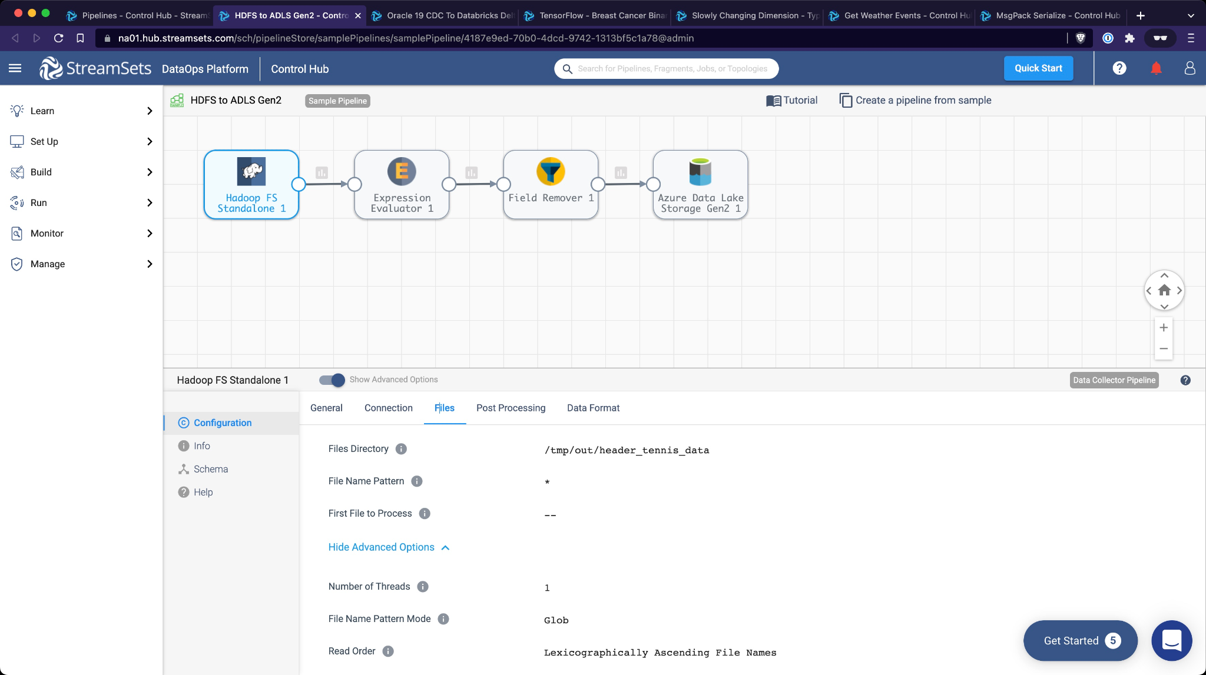

OnPrem Hadoop to Cloud Object Storage
Pattern: Migration
Mode: Streaming
Origin
Dest
Engine Location:
Engine Env:

Slide 14
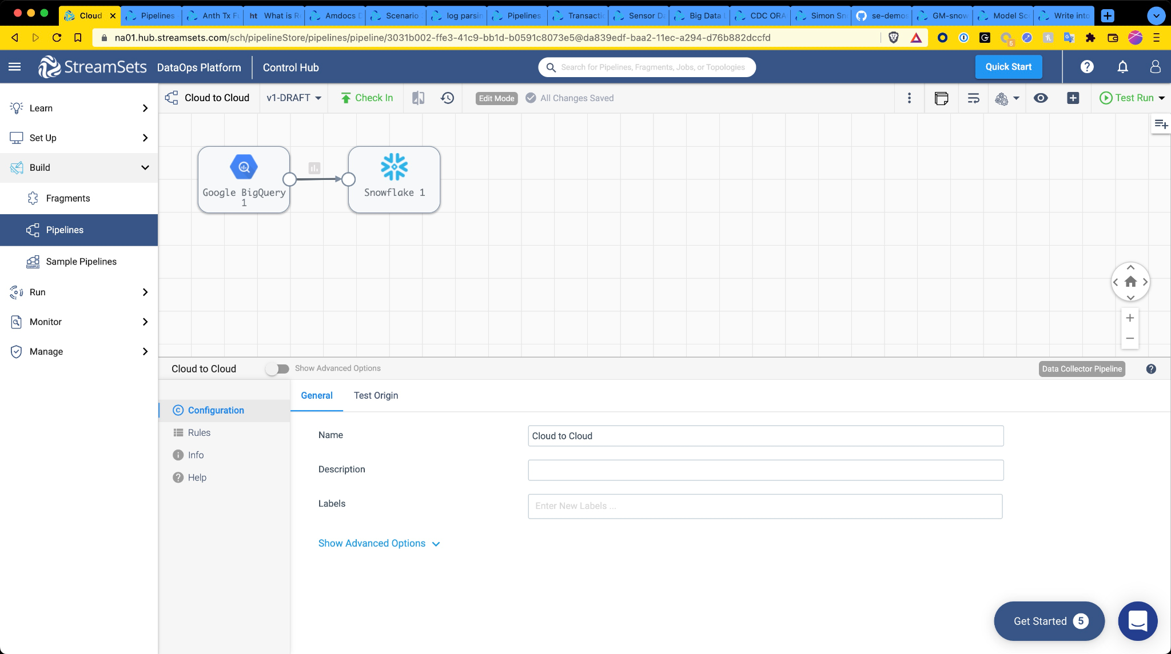
Cloud to Cloud Migration
Pattern: Migration
Mode: Streaming
Origin
Dest
Engine Location:
Engine Env:

Slide 15
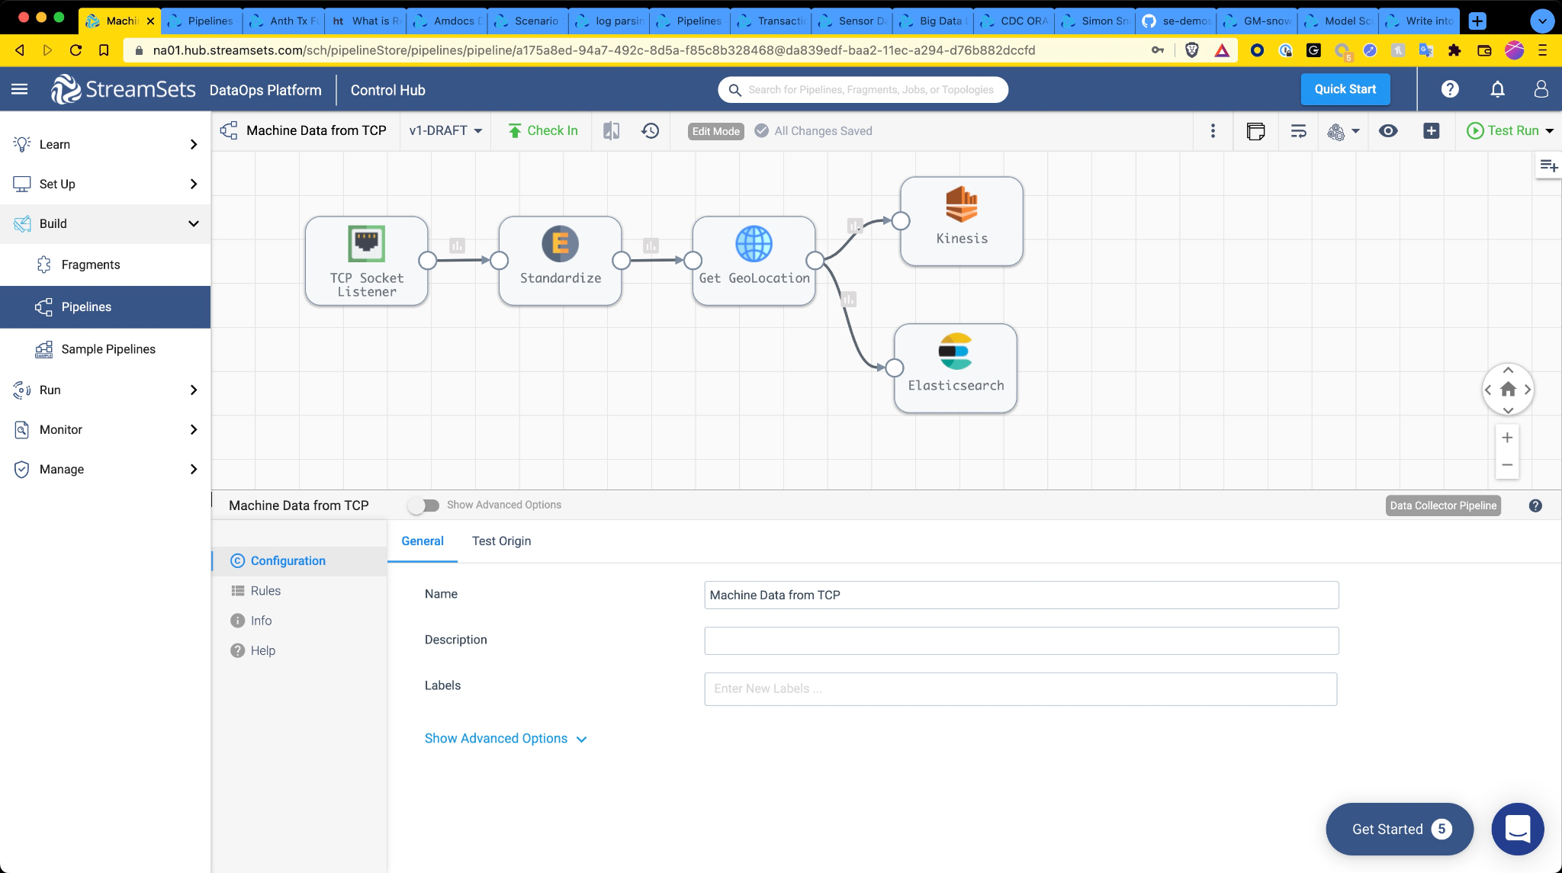
IoT Ingest to Cloud
Pattern: Ingest
Mode: Streaming
Origin
Dest
Engine Location:
Engine Env:

Slide 16
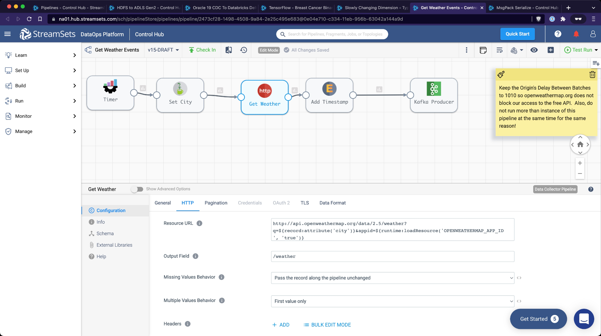
REST API Enrichment
Pattern: Ingest
Mode: Streaming
Origin
Dest
Engine Location:
Engine Env:

Slide 17
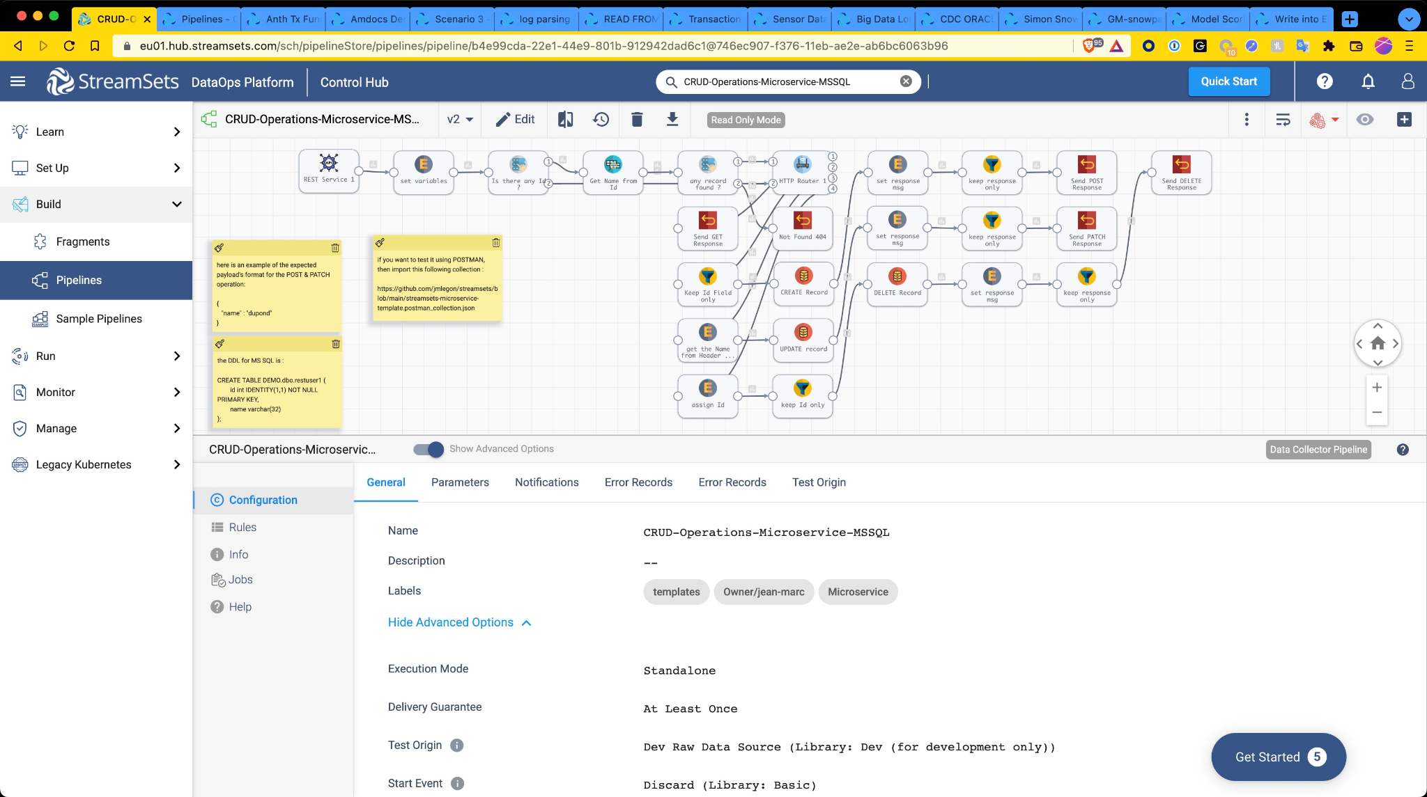
MicroService wrapper on Database Lookup
Pattern: Microservice
Mode: Real Time
Origin
Dest
Engine Location:
Engine Env:

Slide 18
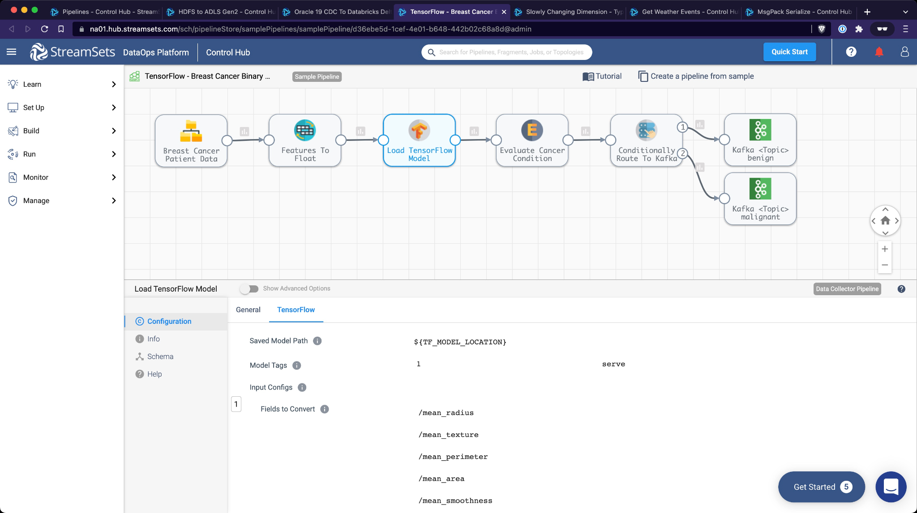
Application of ML Model In Flight
Pattern: AI / ML
Mode: Streaming
Origin
Dest
Engine Location:
Engine Env:

Slide 19
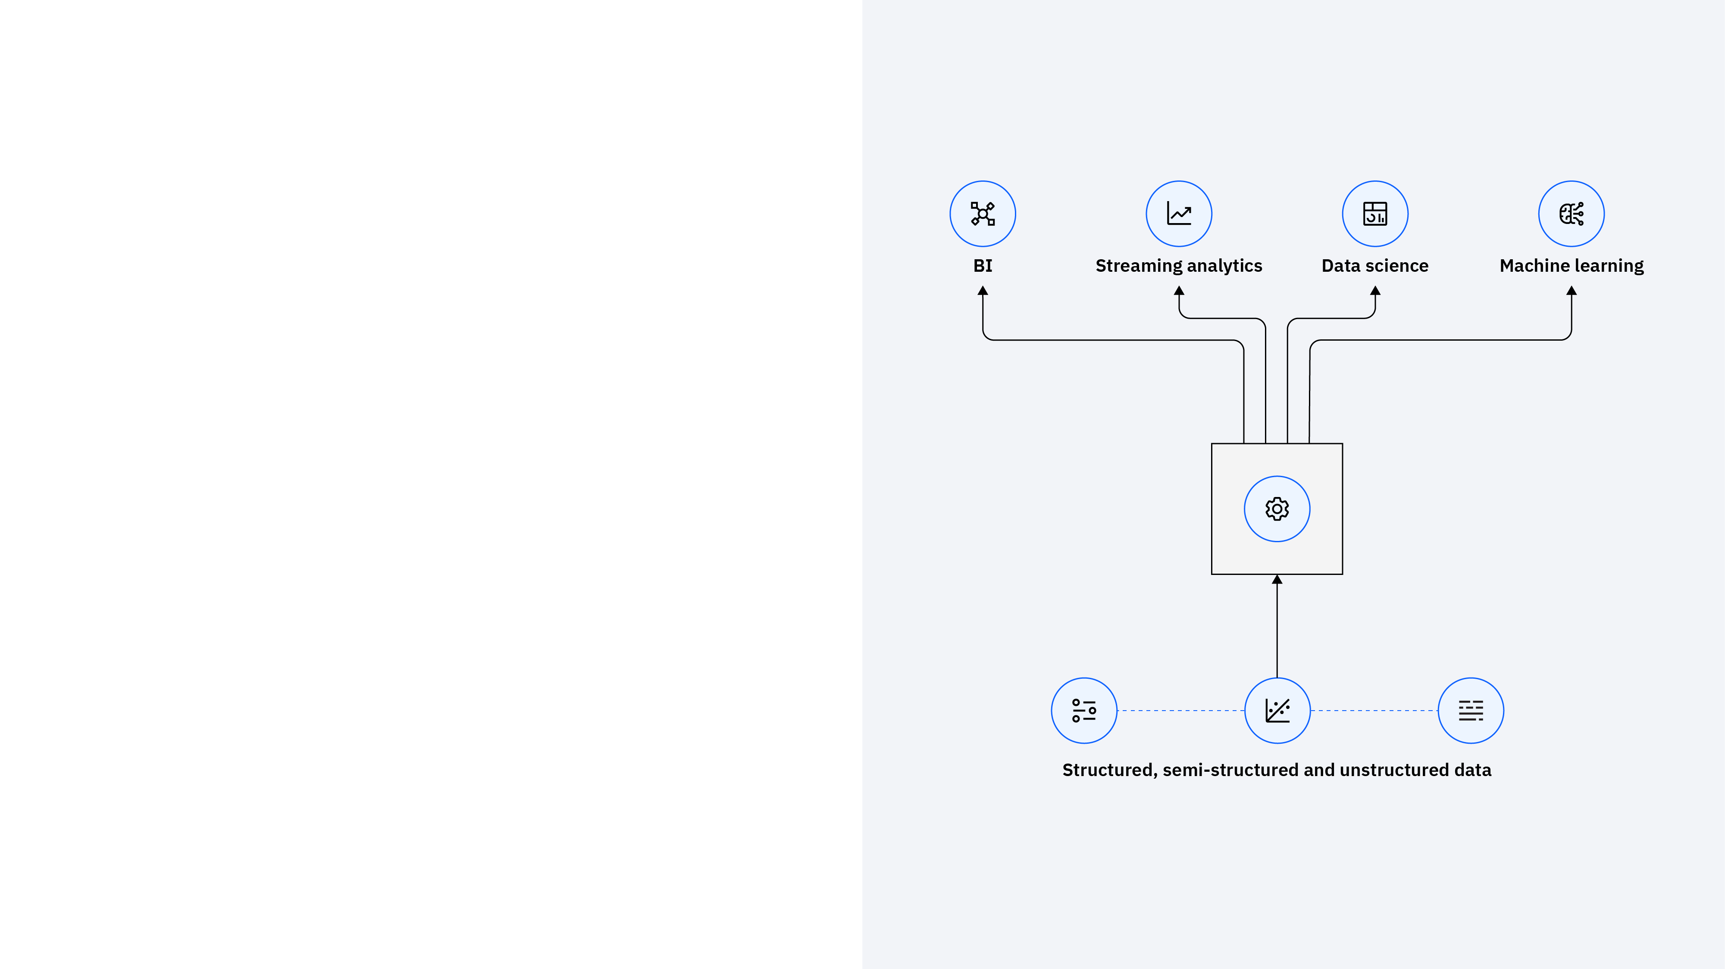
Intro of Use Case
DEMO
Quantum Bank is a leading financial institution operating across multiple regions, processing millions of transactions daily. Reacting to financial risk in real-time is critical to ensuring regulatory compliance and preventing fraud.
However, Quantum Bank’s financial data is scattered across multiple databases and data warehouses. The risk and analytics teams need to:
Break the data silos to get a unified view of financial risk.
Continuously monitor and analyse transactions in near real-time.
Implement a cost-effective and high-performance data solution for deep analytics and AI.

Slide 20

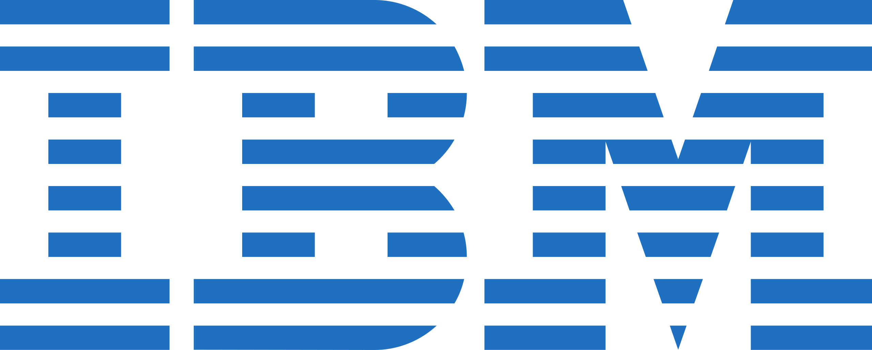
DEMO
My name is Daniel, and I am a Machine Learning Engineer at Quantum Bank.
In my company, there are several key requirements:
Deploy machine learning models to assess customer repurchase likelihood in real-time
Shift from batch processing to real-time predictions for instant decision-making
Integrate the prediction system with business platforms for automated decisions with confidence scores.
Credit prediction for repurchase decisions is currently delayed due to batch processing. A real-time solution is needed to enable immediate credit risk assessment when a customer attempts to repurchase.

Slide 21
Notes:
This self-explanatory slide does not require speaker notes.

